Slide 1

Promo vs. Non-Promo GMV Deep Dive Analysis
JAN’2012 – FEB’2022

Slide 2


Concept Statement
It has been observed that YoY
Non-Promo GMV growth for Retail has been declining and below Promo GMV growth for the past 3-4 years. Investigate the point at which this trend started happening, subsequently what was the driver.

Slide 3
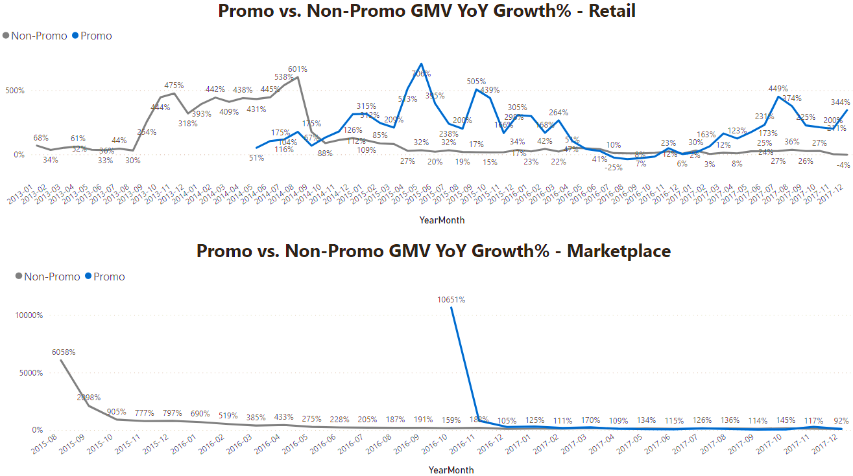
The YoY Non-promo GMV growth for Retail was gradually increasing until August 2014. A sharp drop can be observed between August 2014 and October 2014, thereafter the YoY non-promo growth continued in a downward trend. On the contrary, the Retail YoY Promo GMV growth started rising above non-promo growth in the same period Aug’2014-Oct’2014. Despite some fluctuations over the years in the Promo GMV growth, it continued to grow above non-promo GMV.
The YoY Promo and Non-Promo GMV growth for Marketplace has been following a similar trend.
Retail YoY Non-Promo GMV growth started declining while Promo increased

Slide 4
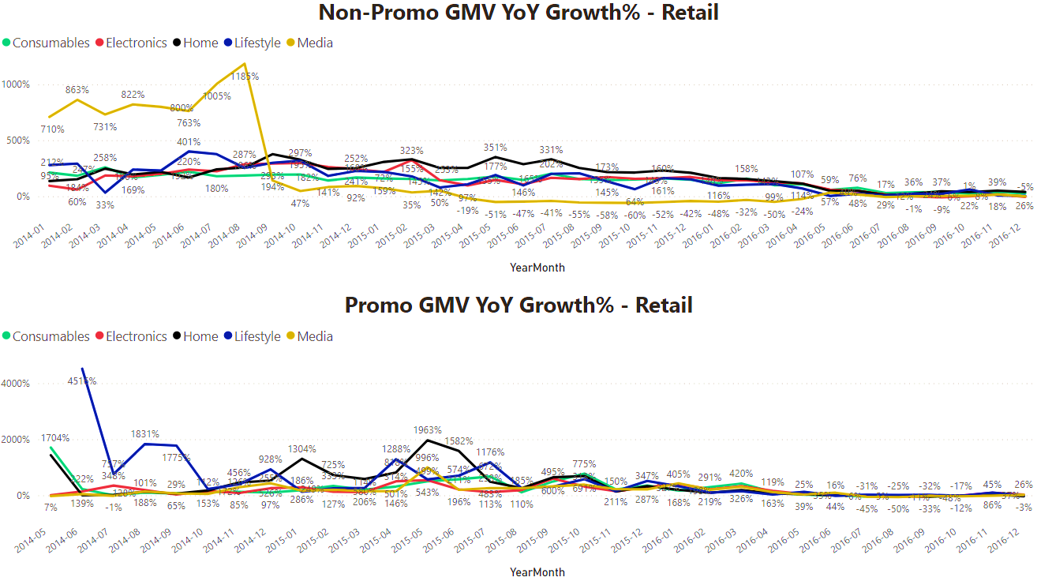
When the Retail YoY Non-promo GMV growth started declining between Aug’2014-Oct’2014 (as pointed out in the previous slide), it was mainly driven by the Media division. On the other hand, when the Retail YoY Promo GMV started rising above YoY non-promo GMV in the same period Aug’2014-Oct’2014, it was mainly driven by Home and Lifestyle division with the highest YoY Promo growth compared to other divisions.
Retail YoY Non-Promo GMV growth started declining while Promo increased

Slide 5
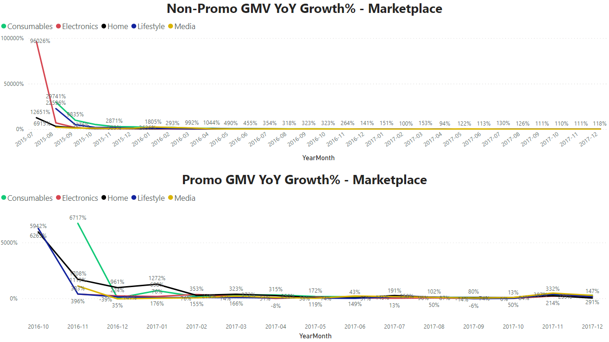
The Promo and Non-Promo GMV YoY growth for Marketplace has been following a similar trend across all Divisions.

Slide 6
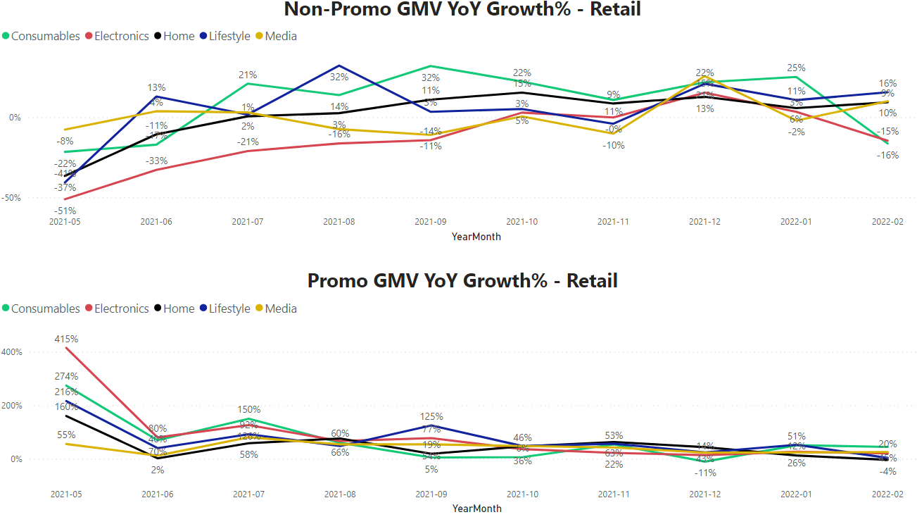
The most up to date (2021’Feb vs. 2022’Feb) YoY Non-promo GMV growth for Retail shows a negative growth of -4%. This is mainly driven by Electronics and Consumables division with a YoY non-promo GMV growth of -15% and -16%, respectively. The other Divisions have a positive YoY non-promo growth.
On the contrary, the most up to date YoY Promo GMV growth for Retail shows a positive YoY growth for all Divisions except Home with a
-4% YoY Promo GMV growth.

Slide 7
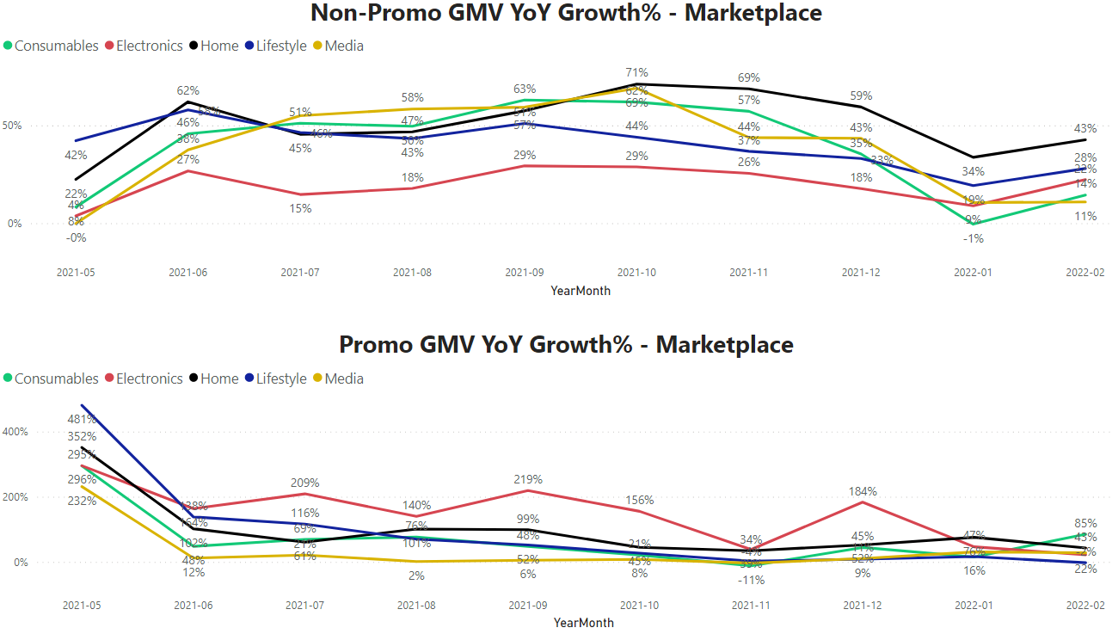
The most up to date (2021’Feb vs. 2022’Feb) YoY Non-promo and Promo GMV growth for Marketplace shows a positive Non-promo GMV growth across all Divisions. The same positive growth can be seen for Promo GMV across all Divisions except Lifestyle with a -2% YoY Promo GMV growth.

Slide 8
Reasons why Retail has a negative Non-Promo YoY growth for Feb

Slide 9
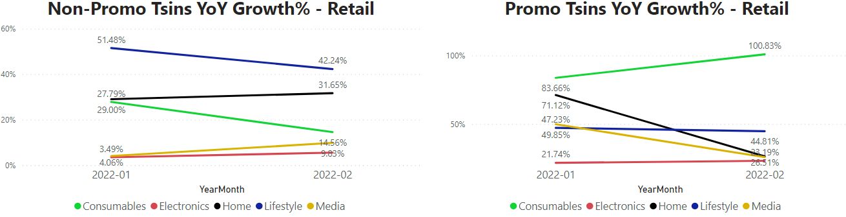
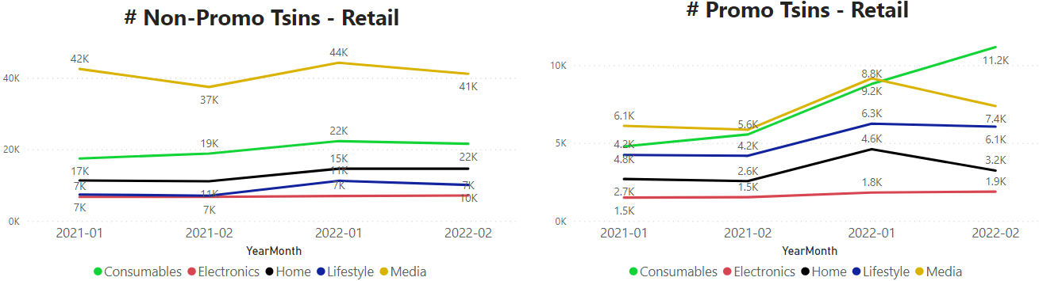
We have seen that Consumables contributed the most to the negative YoY non-promo GMV growth, this is because their YoY non-promo Tsins growth decreased while their YoY promo Tsins growth increased.

